Slide 1
Induction Motor Fault Diagnosis using Convolutional Neural Networks
BEE-15-D
Group # 1
Group members:
Kumail Ahmed
Muhammed Ahmed
M. Farhan Shah
Huzyepha Javaid
Shaheer Asghar

Slide 2
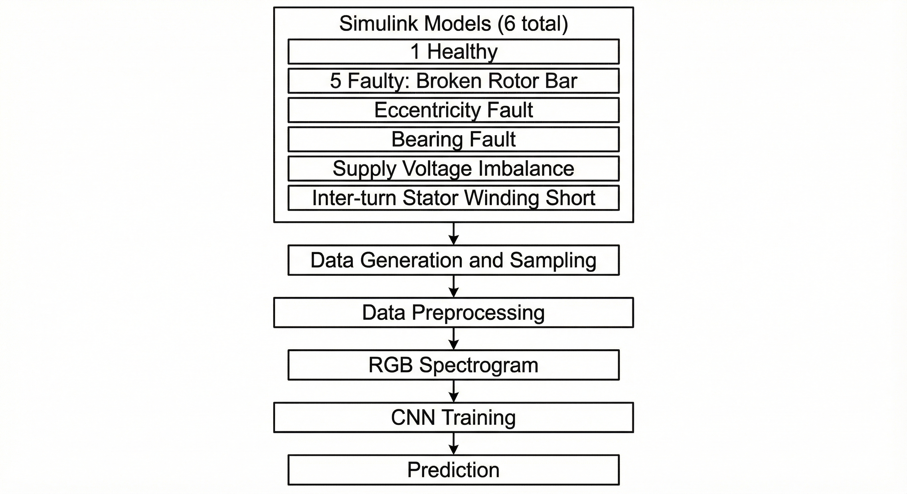
Introduction
Induction motors power a major portion of industrial machinery and processes.
Unexpected motor failures can lead to serious safety risks and significant production downtime.
Traditional fault diagnosis depends on expert manual interpretation, which is costly and prone to human error.
There is a strong need for automated and robust fault detection methods that work reliably under real-world variable operating conditions.
Using stator current signals makes the system economically attractive since current sensors are inexpensive and non-intrusive.
The proposed model can differentiate between similar fault signatures even under grid instability, voltage variation, load fluctuations, and noise.
This capability addresses a major challenge in predictive maintenance by enabling accurate and reliable motor health monitoring.

Slide 3
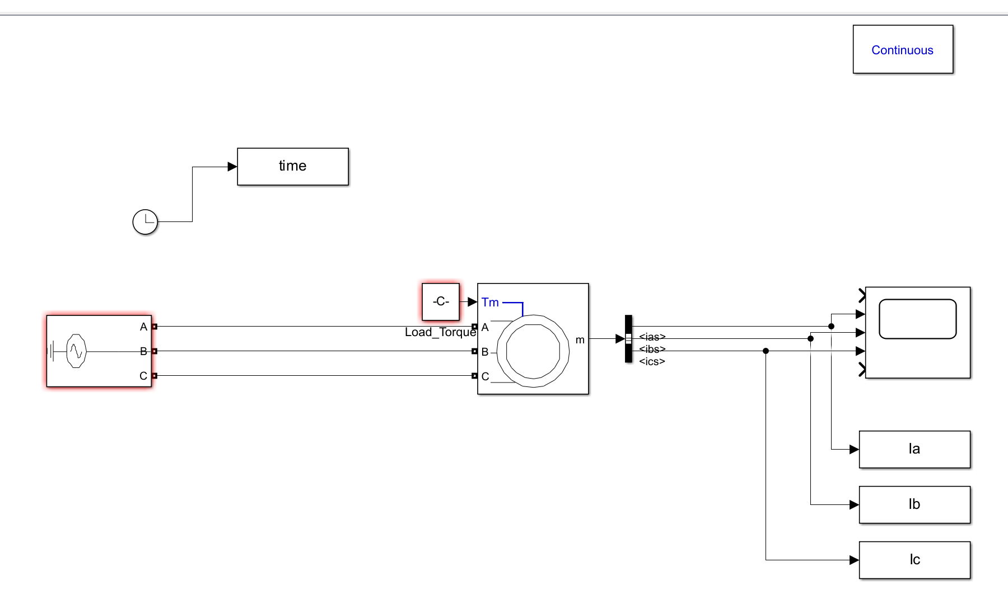
Simulink Models and Working
Healthy
Simulates a healthy three-phase induction motor using an Asynchronous Machine block.
Three-Phase Source supplies power; Load Torque applies mechanical load.
Bus Selector, Scope, and To Workspace blocks monitor and log signals.
Clock and powergui support timing and electrical system simulation.
Designed for analyzing normal/healthy motor performance.

Slide 4
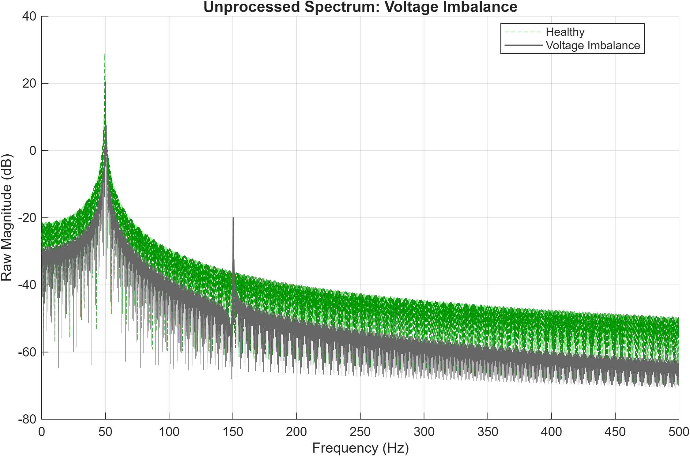
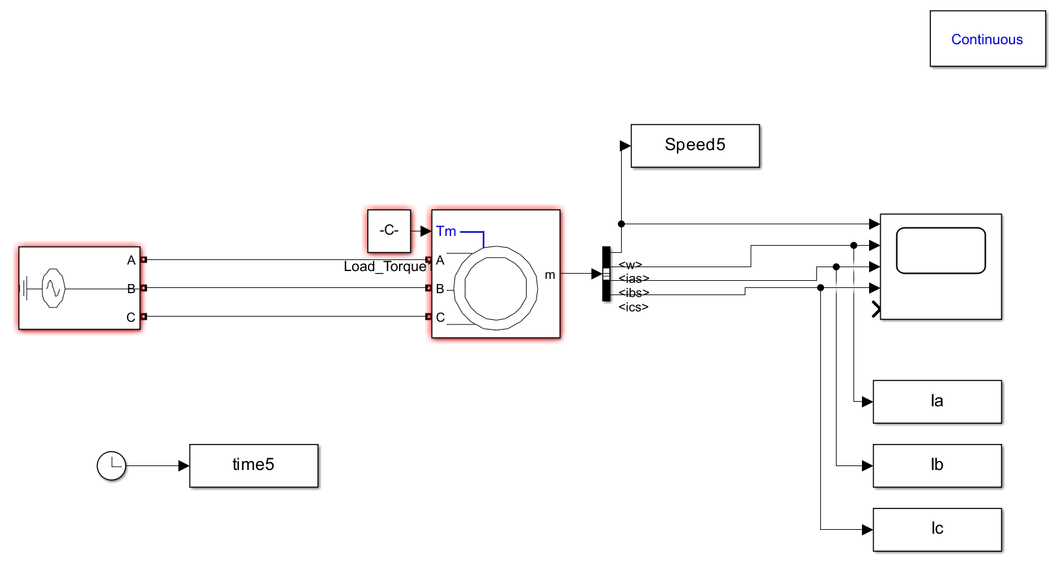
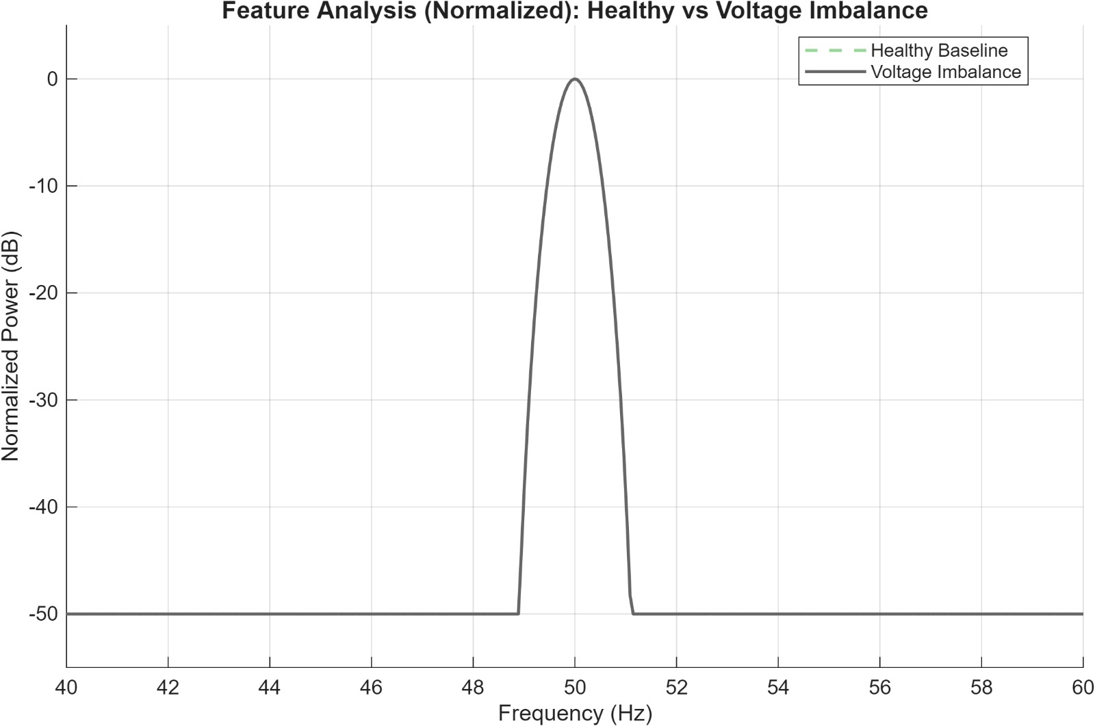
Voltage Imbalance
Supply Voltage Imbalance: Modelled by reducing the amplitude of Phase A by 5%-15%
29% difference in RMS amplitude which is shown as change in average power
Before Data Processing
After Data Processing

Slide 5
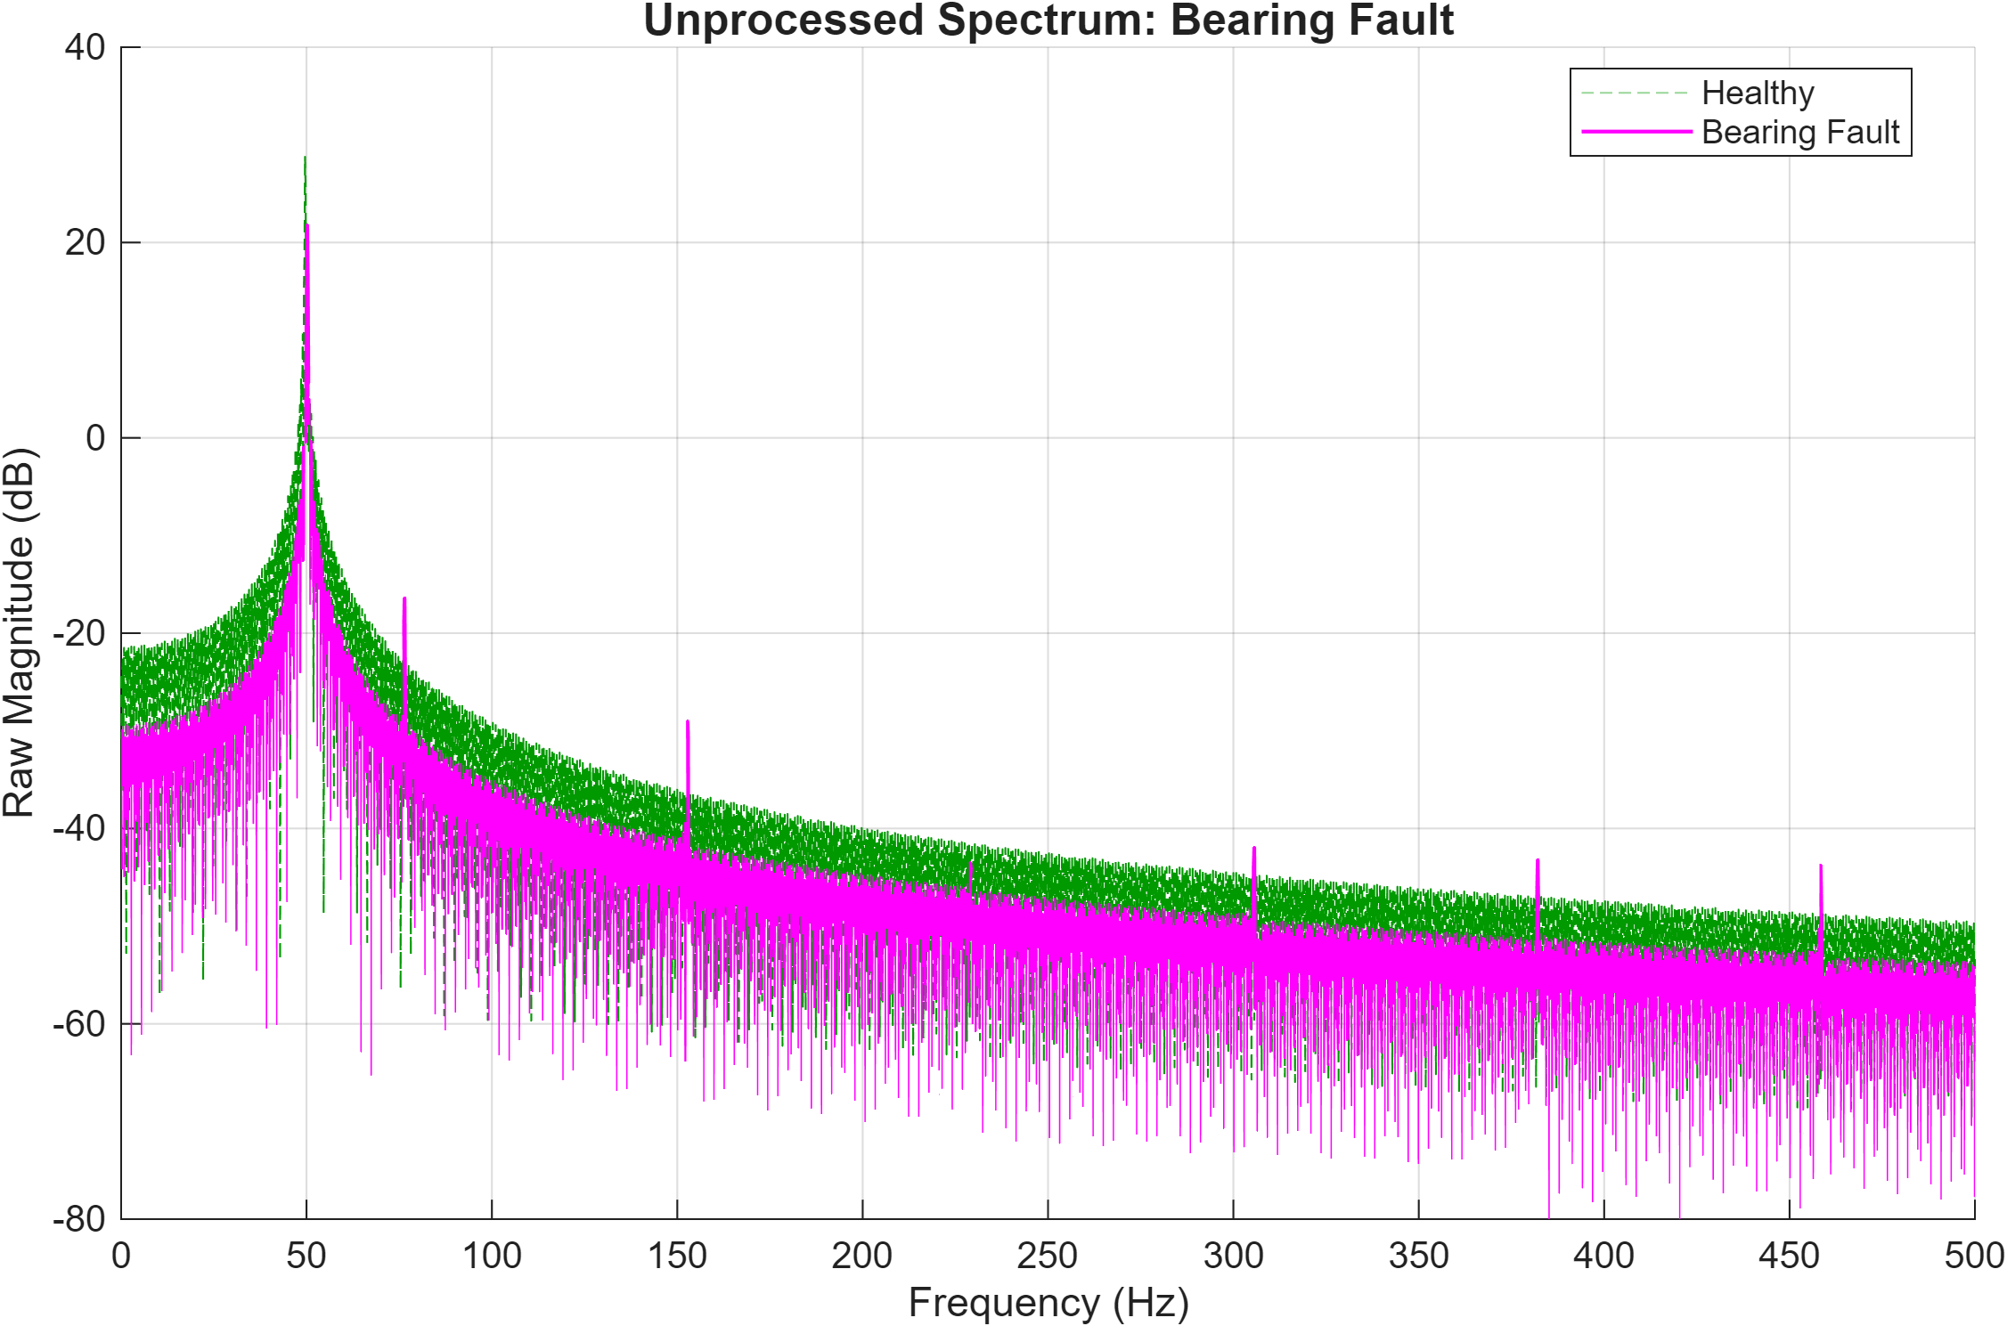
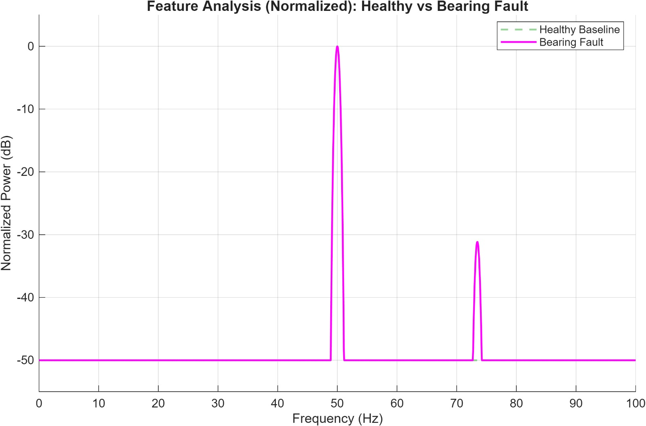
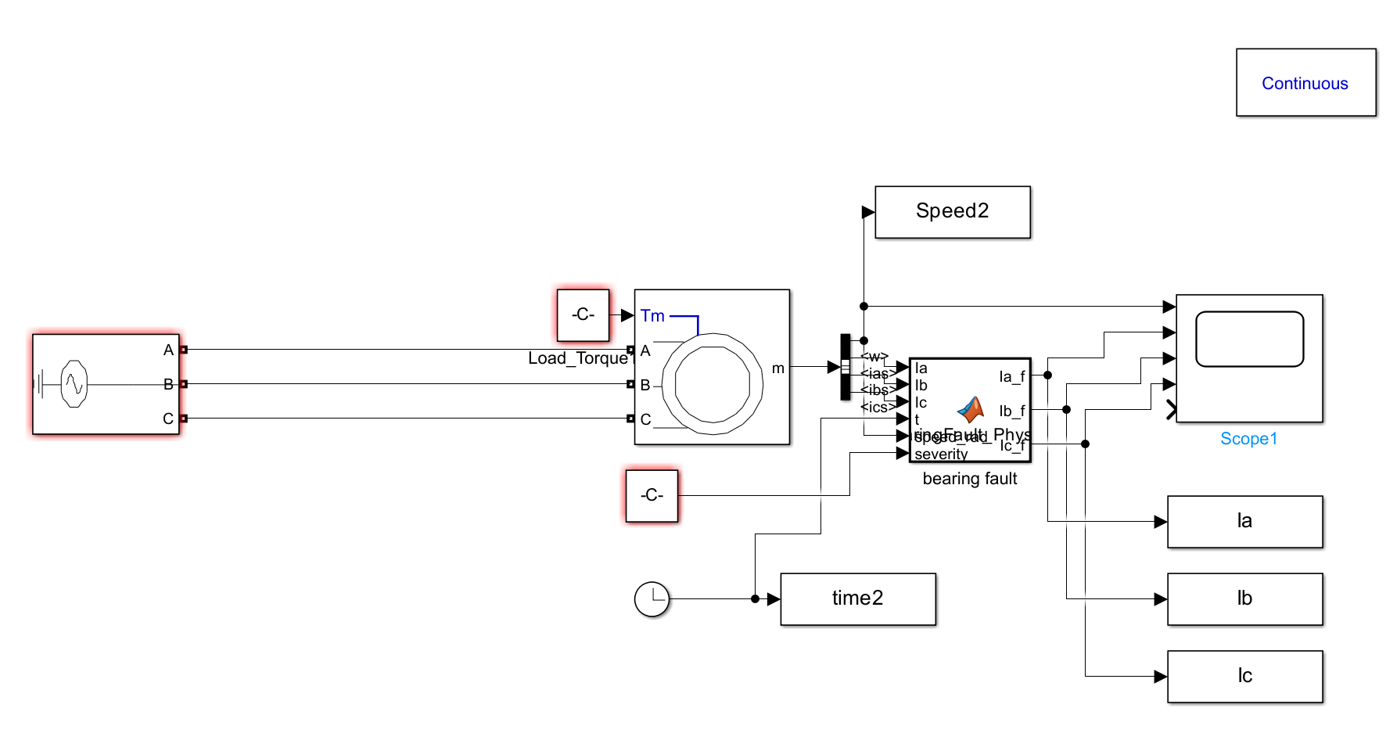
Bearing Fault
Bearing Fault: Modelled as a series of high-frequency impulses and modulations based on Ball Pass Outer Frequency (BPFO)
Strong characteristic peak at 75Hz corresponding to the Ball Pass Outer Frequency (BPFO)
BPFO= n/2 fr(1+Bd/Pd cosB)
Fault Signal: hf_modulation, impulse_train, current_modulation
Before Data Processing
After Data Processing

Slide 6
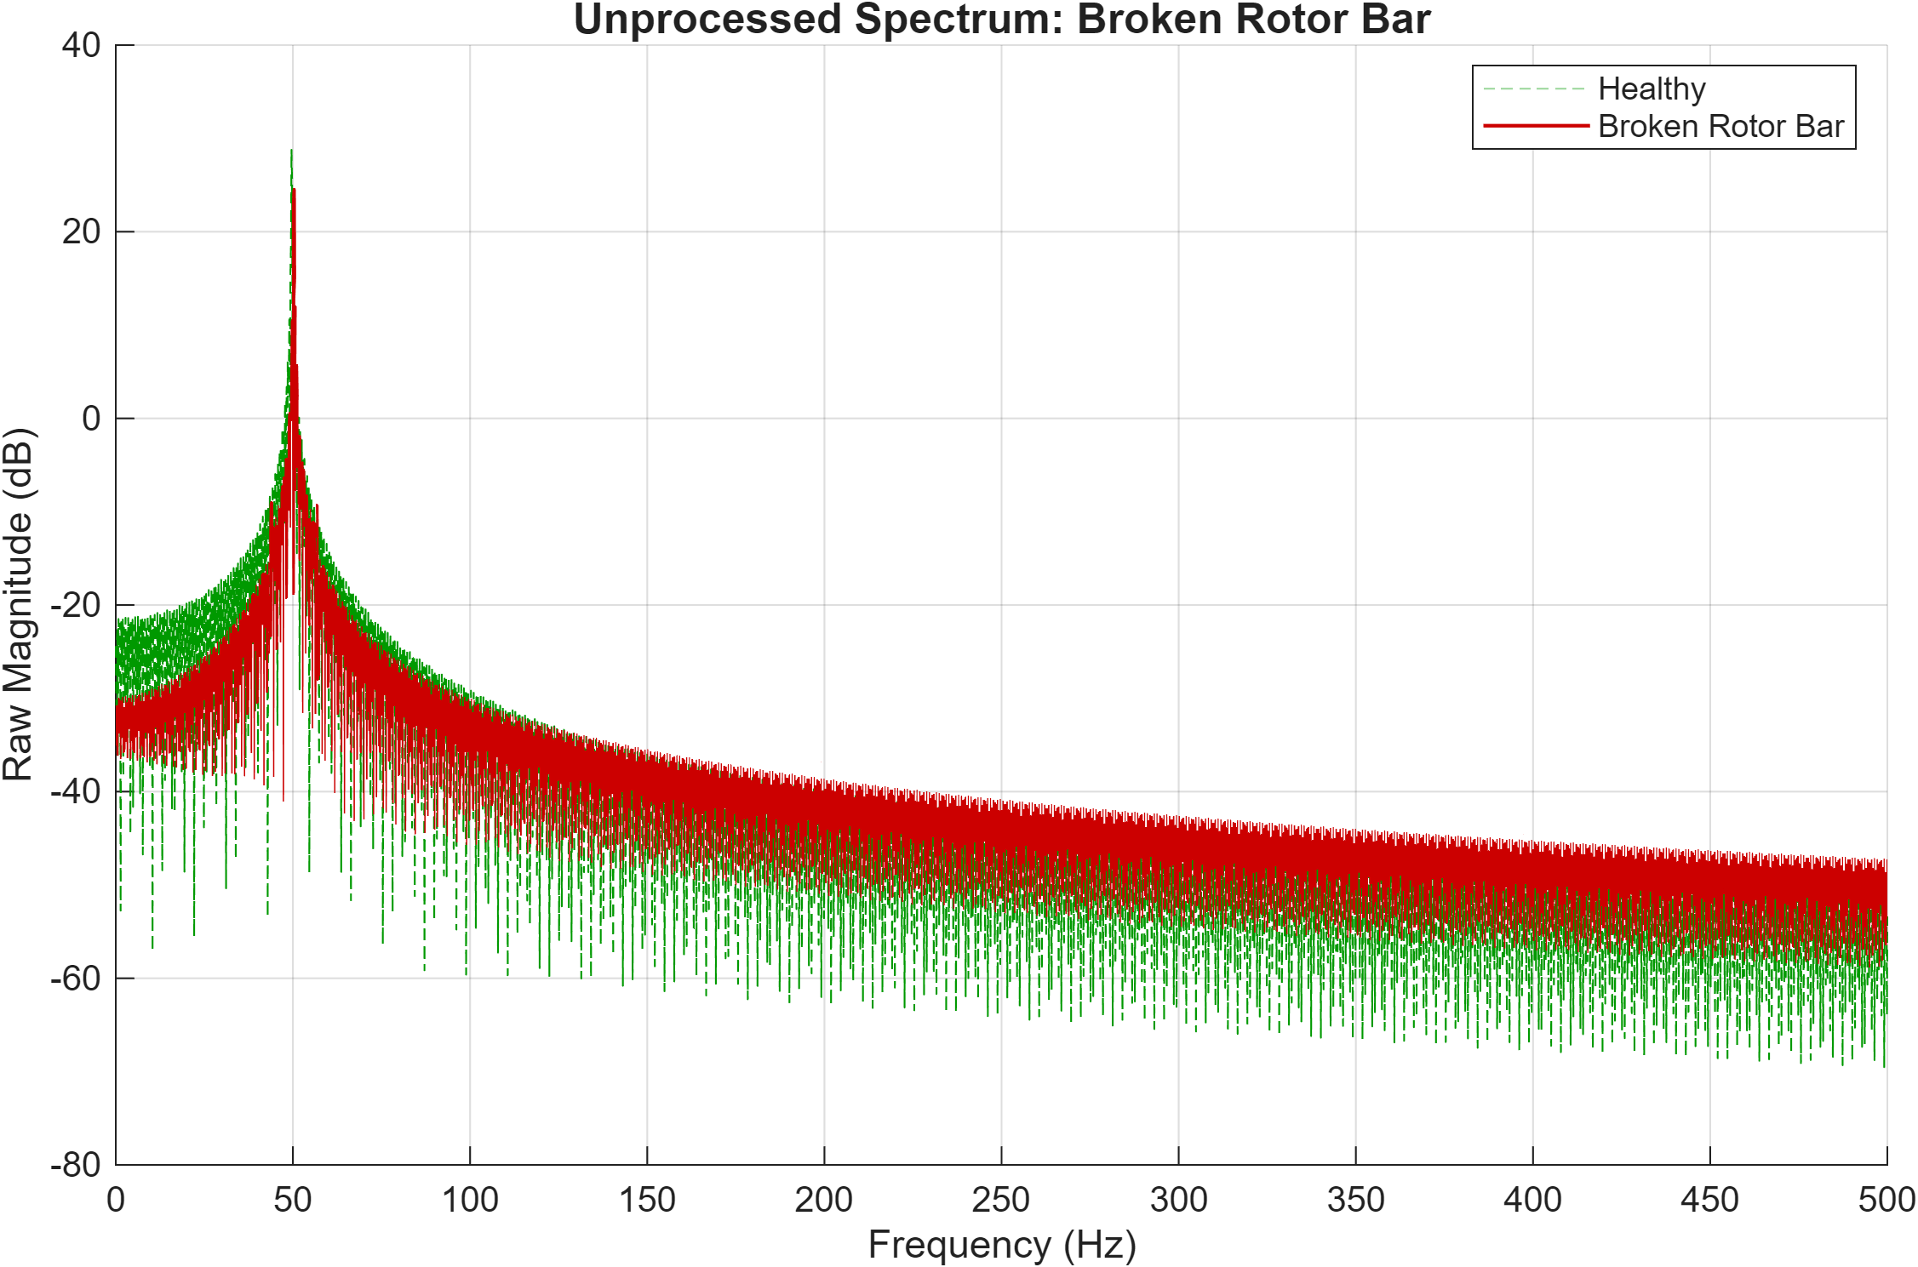
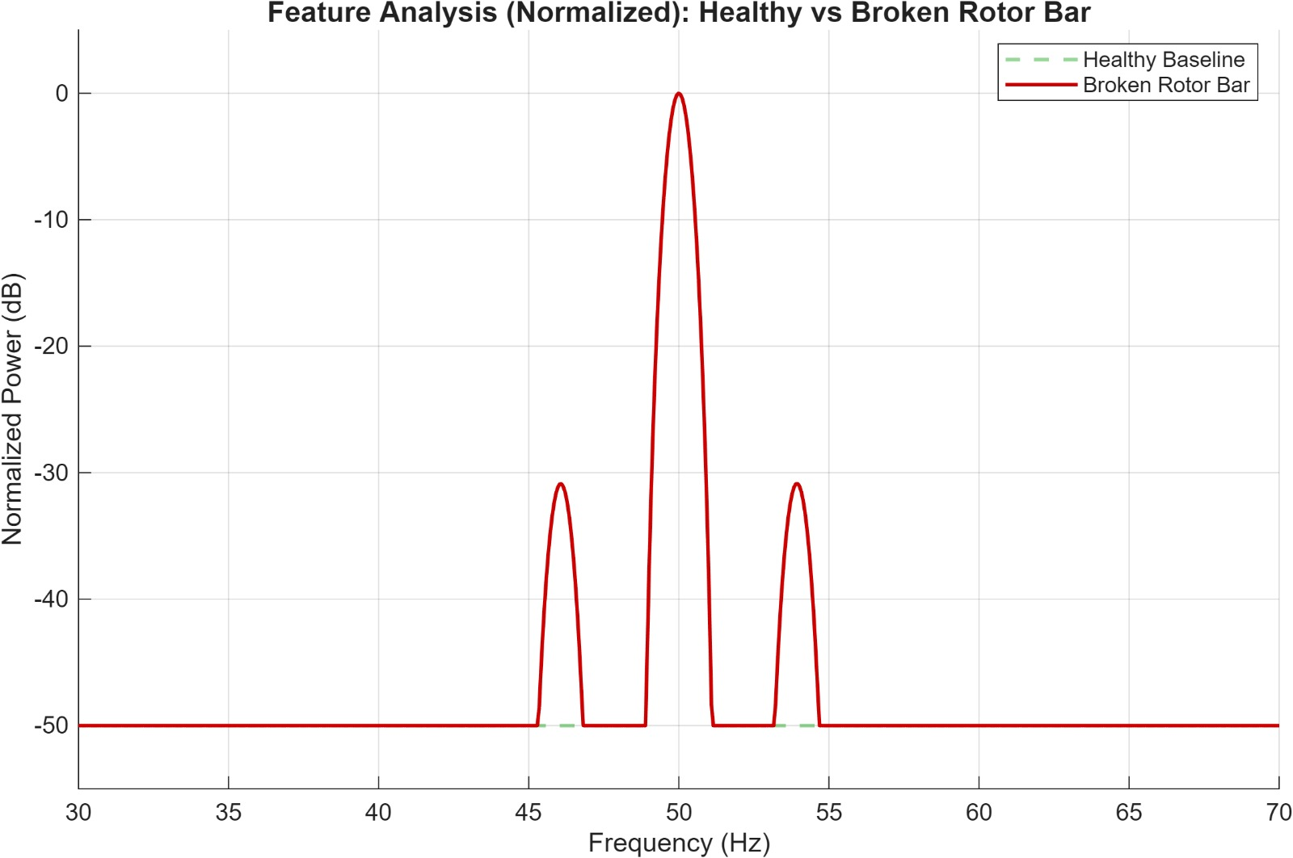
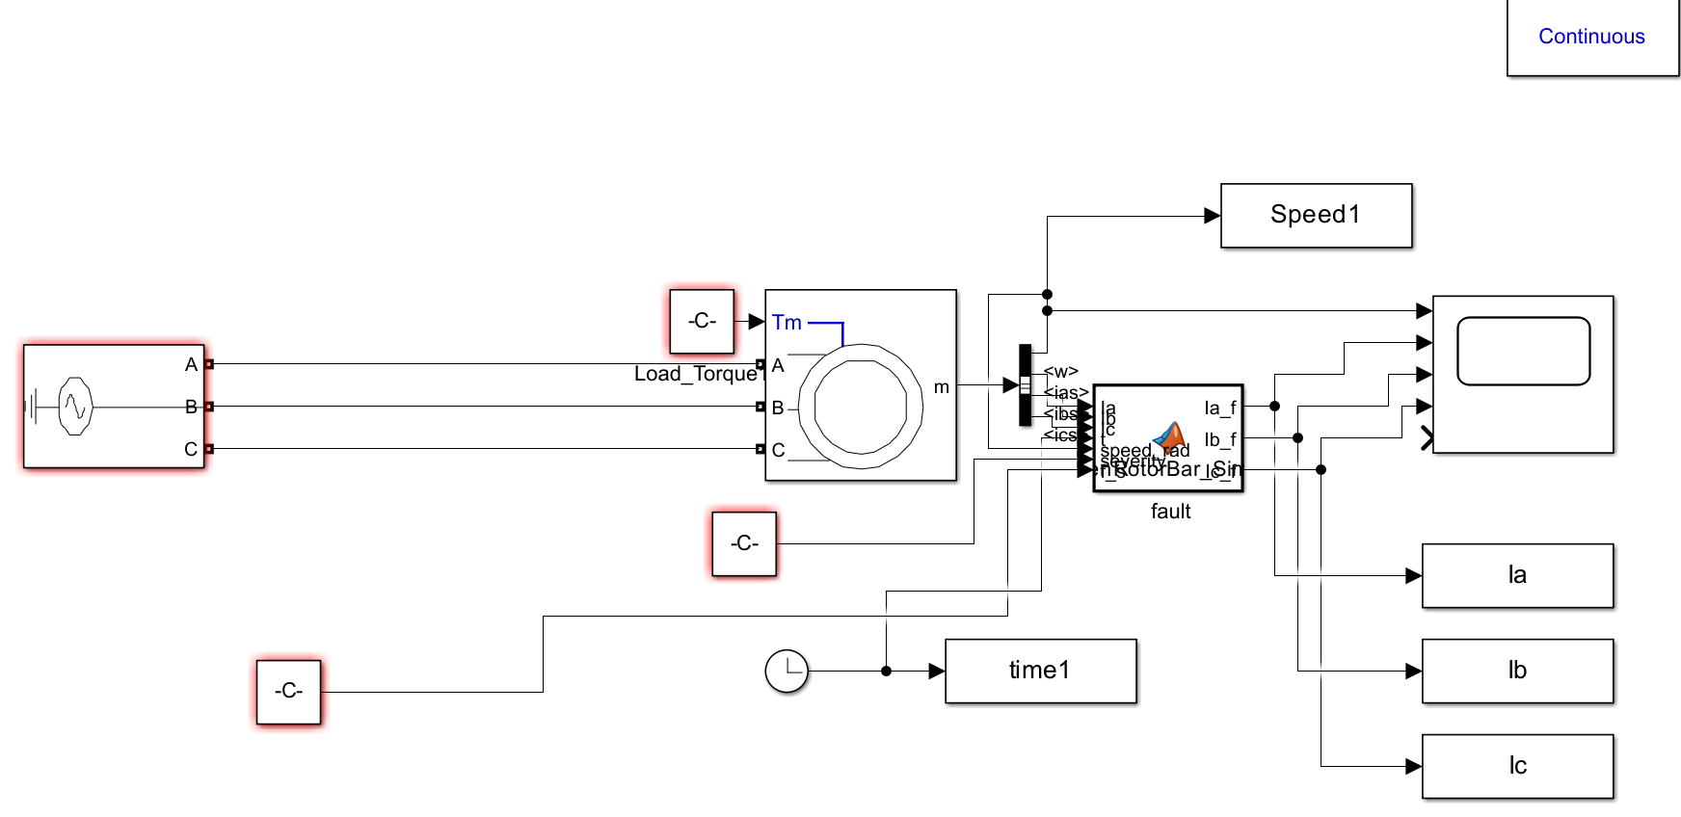
Broken Rotor Bar
Broken Rotor Bar: Modelled via Amplitude Modulation creating side bands at f = fs * 2s
Visible Trident pattern with peaks around the 50Hz fundamental
f=fs(1±ks) k=2,4,6...
Fault Signal: Current _Modulation
Before Data Processing
After Data Processing

Slide 7
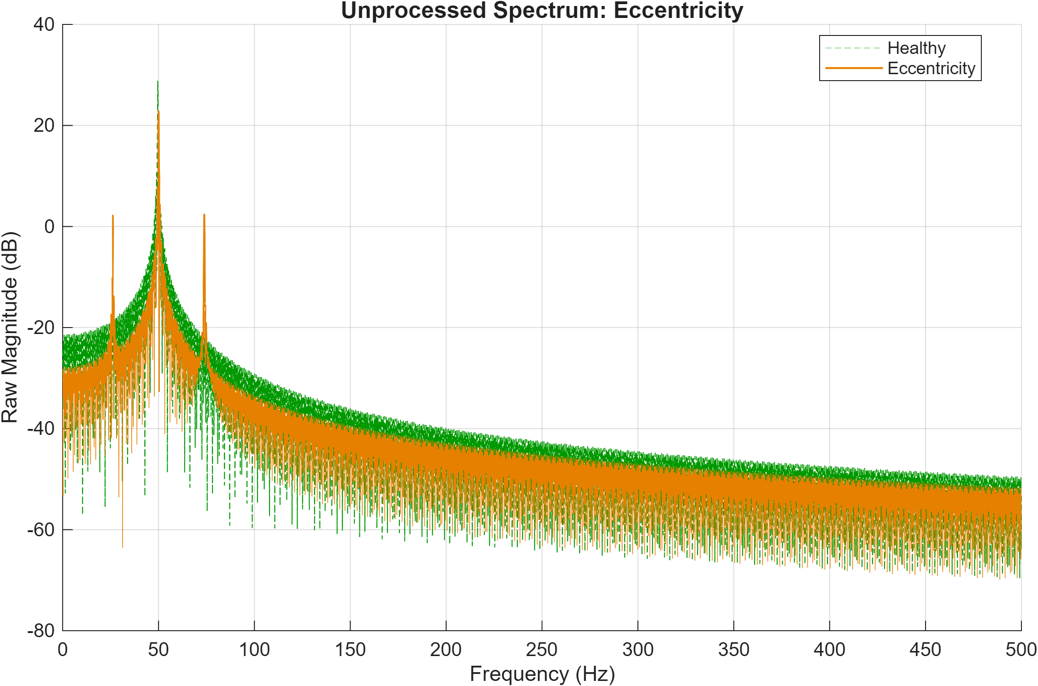
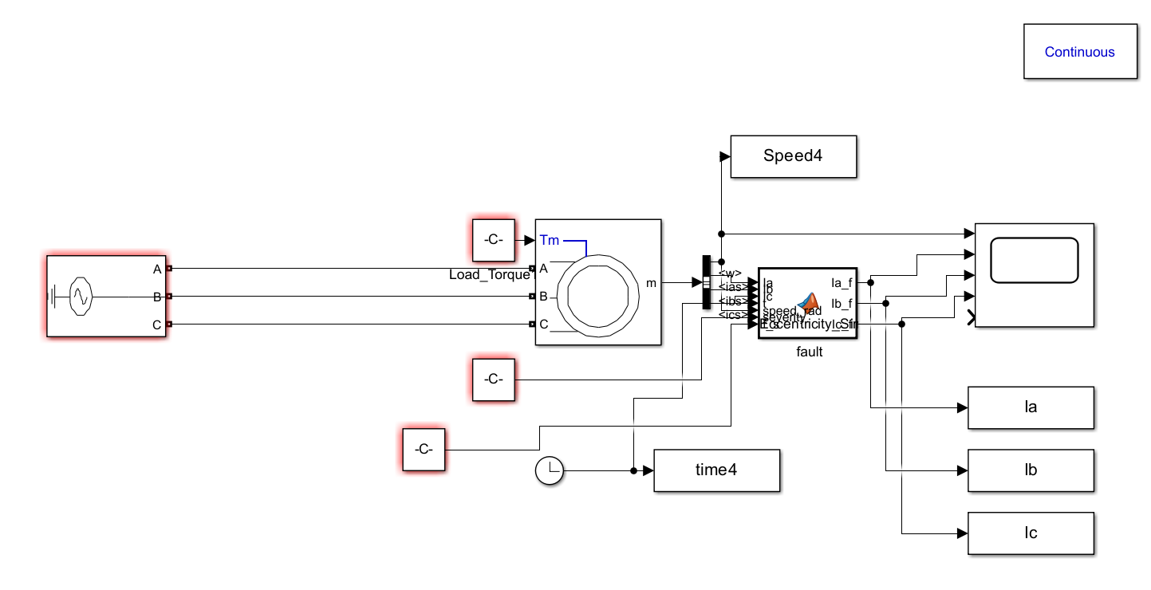
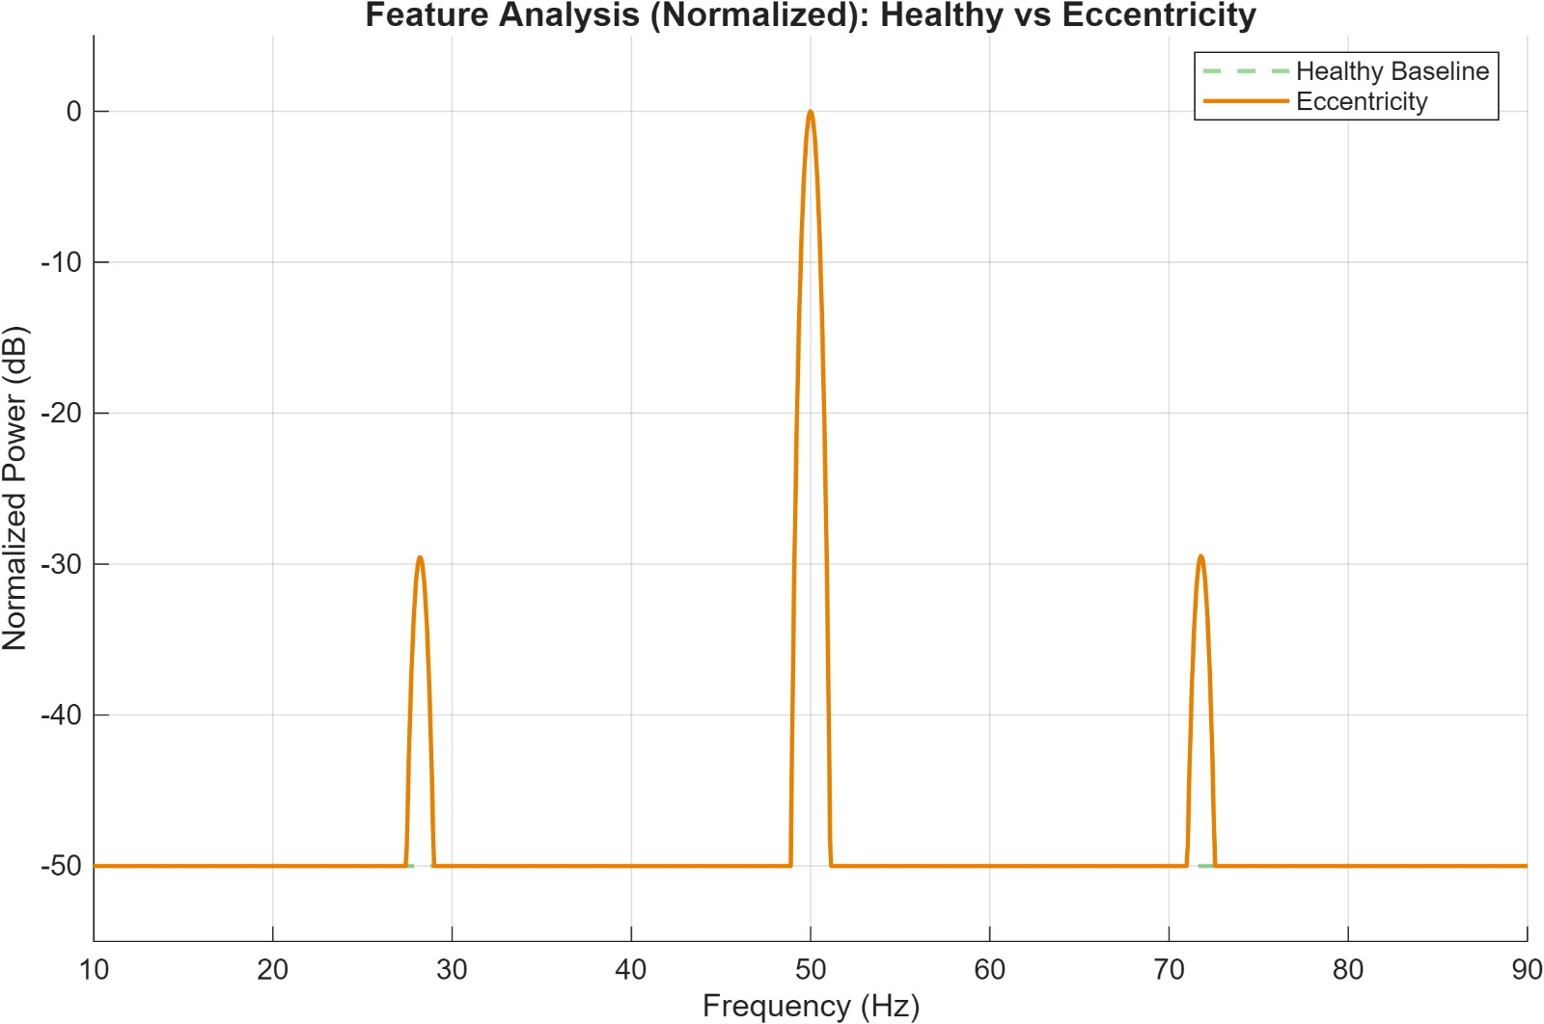
Eccentricity
Eccentricity Fault: Modelled as mixed eccentricity creating sidebands at f = fs + fr
Distinct sidebands at 25Hz and 75Hz
Before Data Processing
After Data Processing

Slide 8
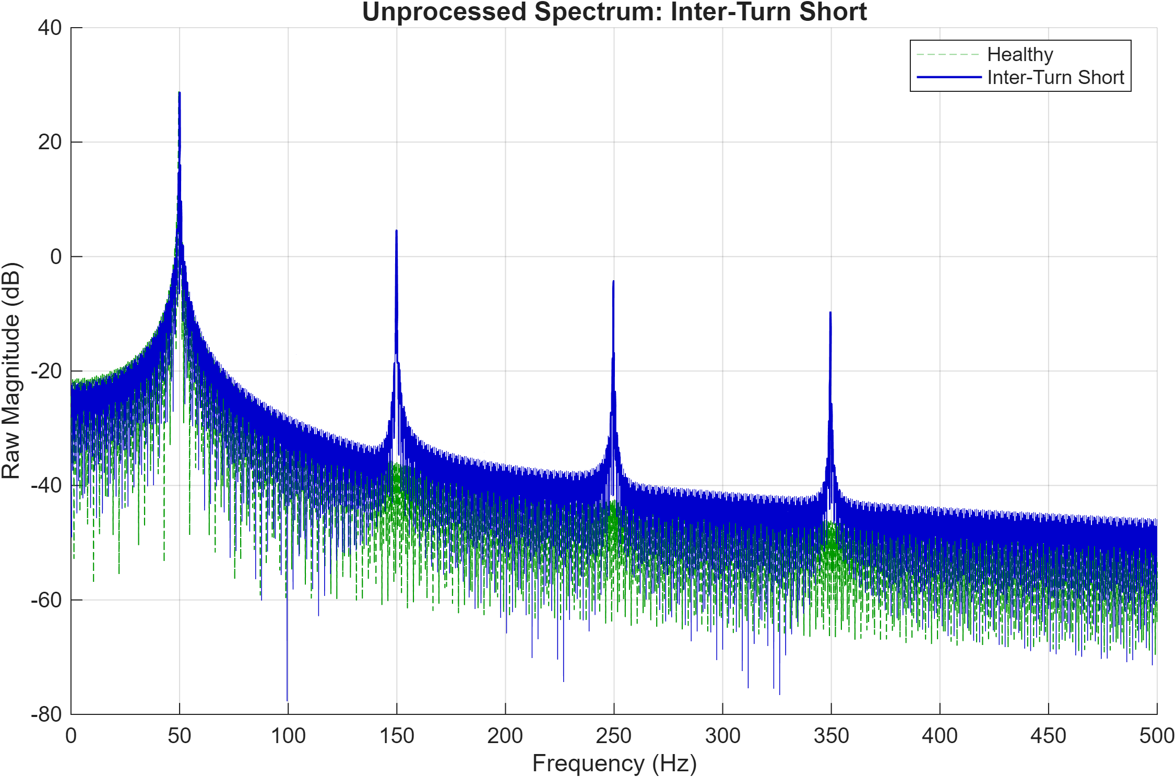
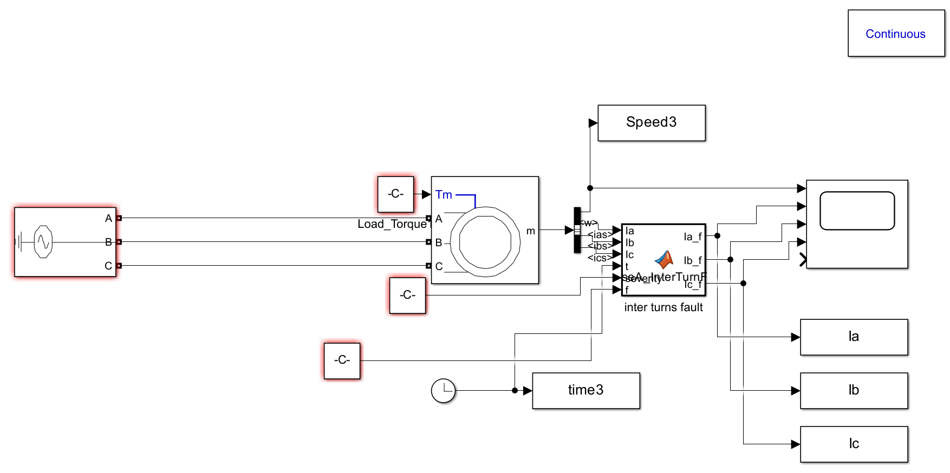
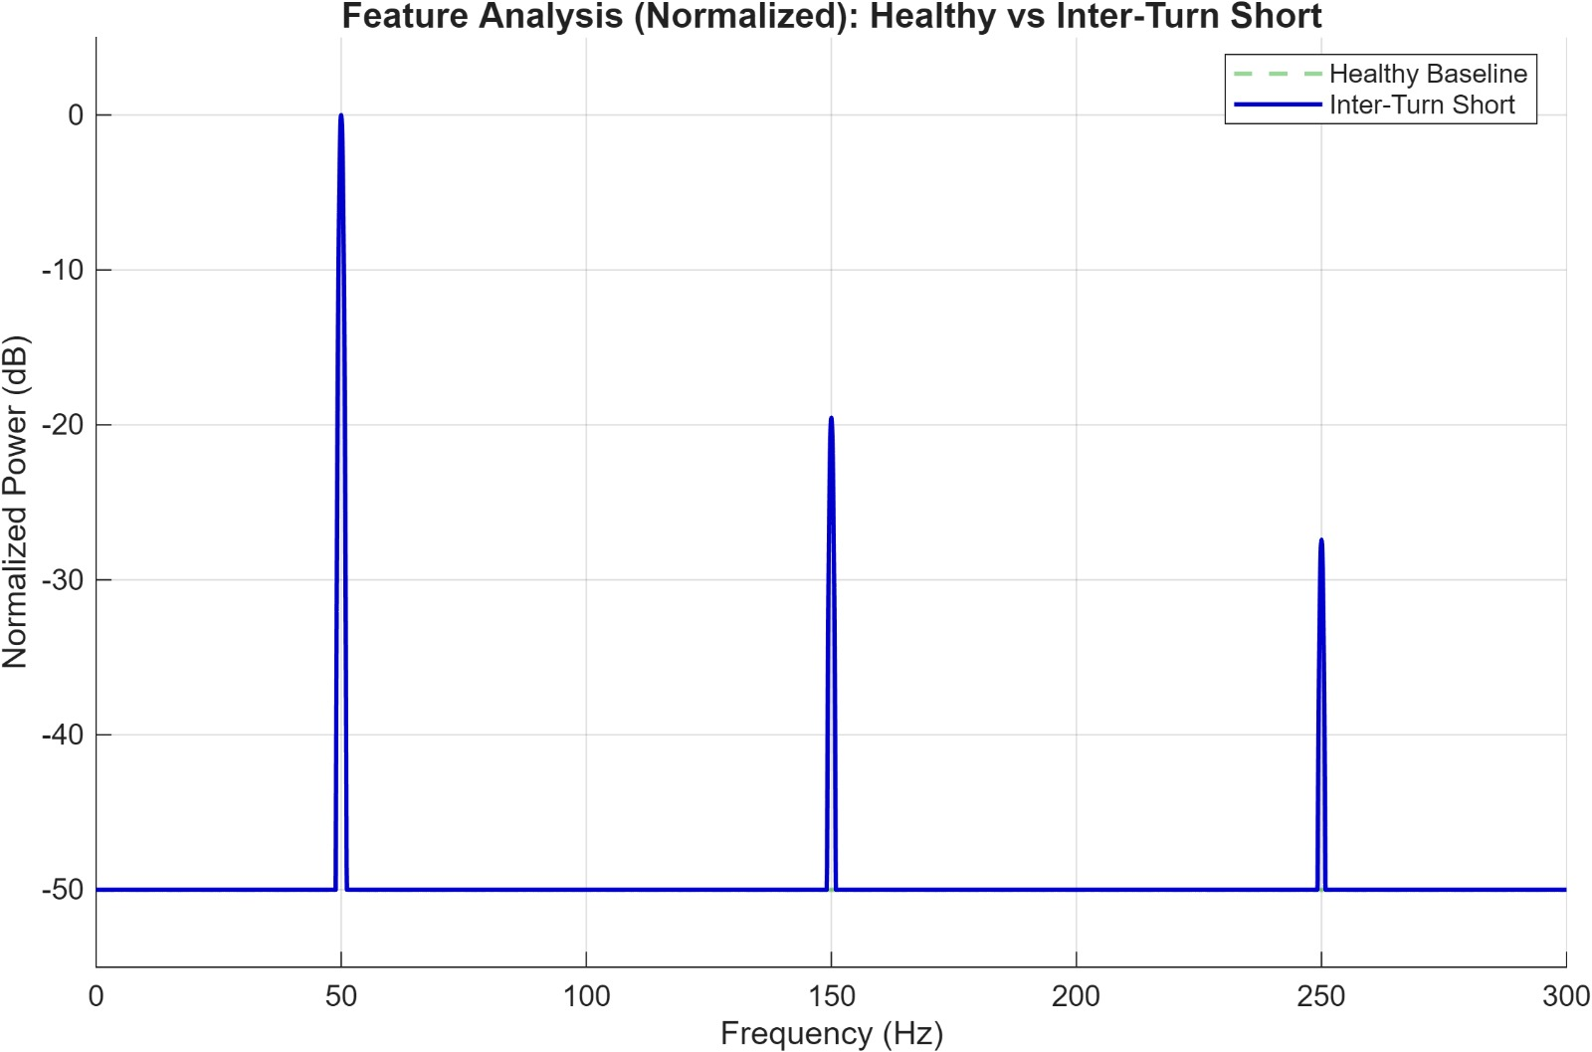
Inter-Turn Short
Inter-Turn Short: Modelled by injecting odd harmonics into the current signal
Strong Peaks detected at 150Hz(3rd Harmonic) and 250Hz(5th harmonic)
Before Data Processing
After Data Processing

Slide 9
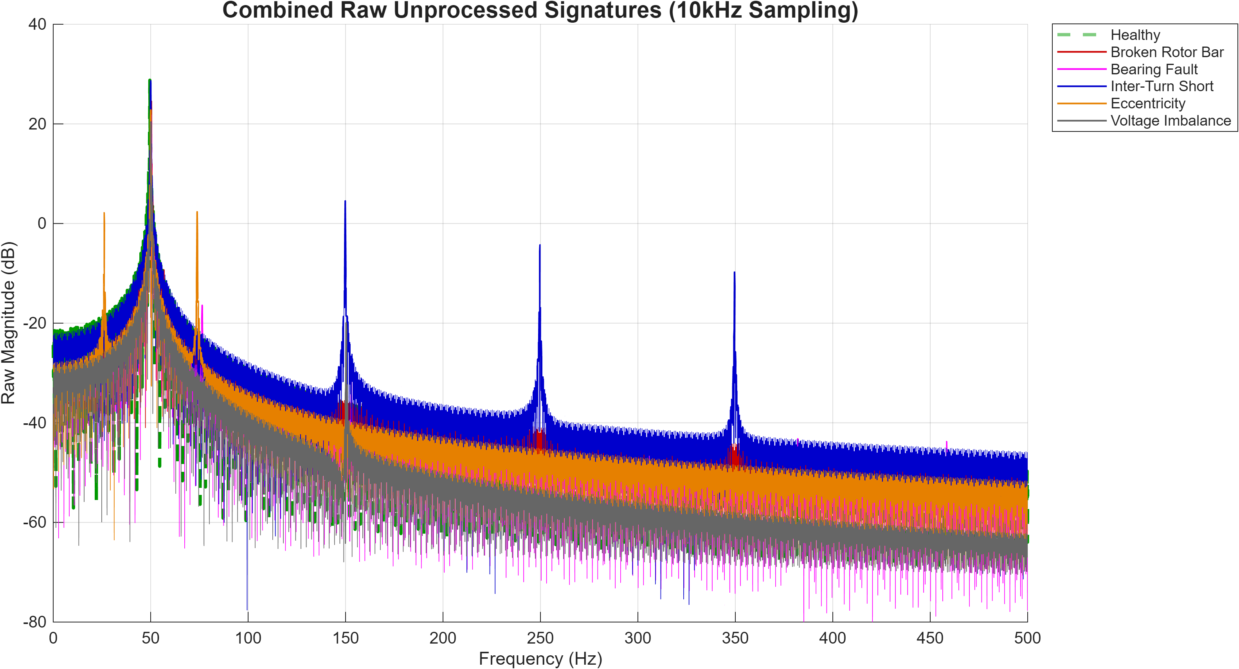
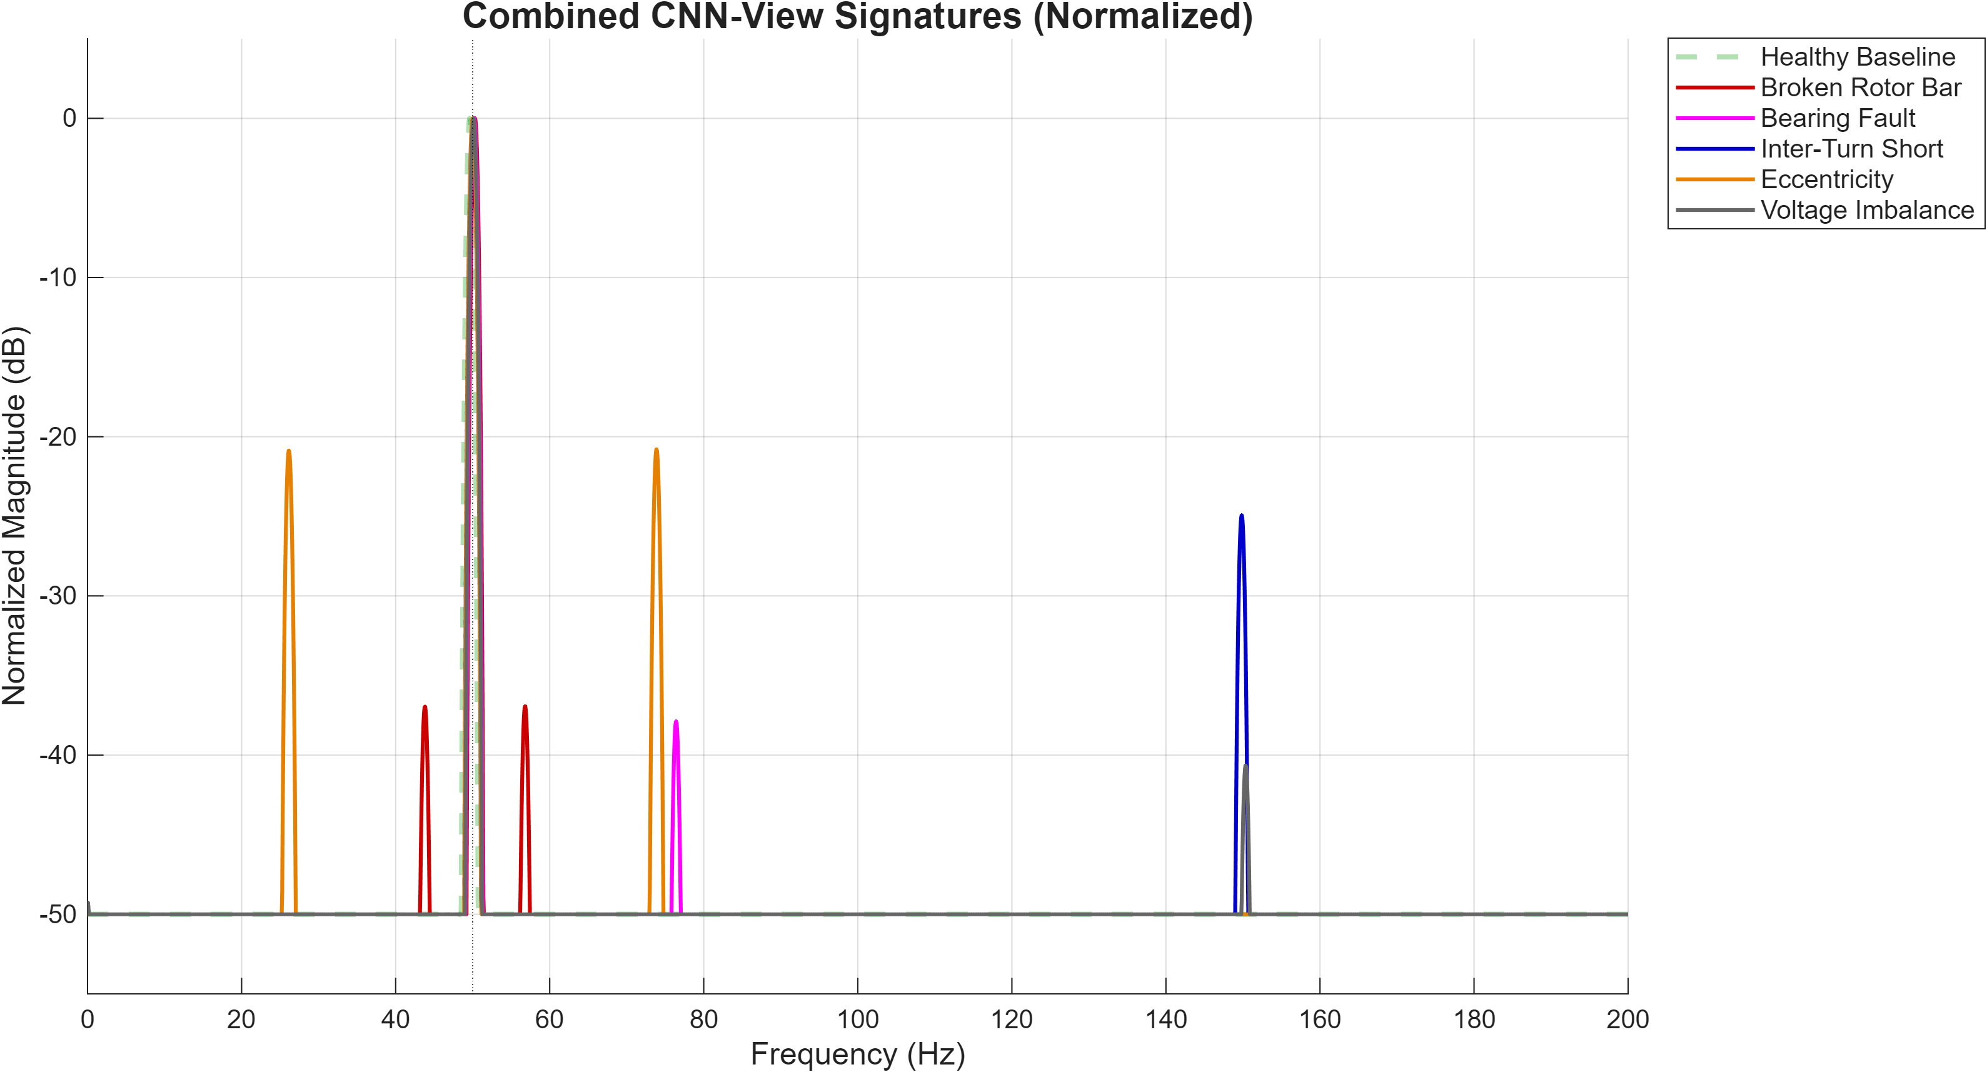
Data Generation and Pre-Processing
We utilized MATLAB Simulink to generate data, using 500 simulations
for each class. Each simulation had data of 5s equating 50000 current
samples (10k sampling frequency) . To ensure the model is robust to
real-world variability, we randomized physical parameters for every
simulation run while adding 1% noise:
Supply Frequency: Randomized between 49.5 Hz and 50.5 Hz to simulate grid instability.
Load Torque: Varied between 10 Nm and 60 Nm to ensure variable slip, which prevents the model from memorizing fixed frequency locations.
Fault Severity: Randomized ranges (0.2 - 0.8 for BRB) to cover minor to severe faults.
Input Voltage: Randomized between 350V and 450V

Slide 10
Signal Processing Pipeline
Down Sampling: The raw 10kHz samples were decimated to 1kHz to zoom in on the range where all fault signatures reside
DC Removal: Mean of signal was subtracted to prevent normalization skew
High Resolution STFT: We implemented a frequency resolution of 0.33Hz to detect minor sidebands like broken rotor bar which are just 1Hz away from fundamental
Chebyshev Windowing: Chebyshev window was applied to enhance the visibility of weak fault signals
Spectrogram Generation: The 3-phase currents were mapped to RGB channels of an image because CNN is best at image classification.
Data Trimming: 5 seconds of simulation data was trimmed to 4s to remove initial transients and spikes when machine starts

Slide 11
CNN Architecture & Technical Training Protocol
1. Deep Learning Architecture
1. Input Stage:
224 x 224 x 3 Image Input (Phase-Encoded RGB: R=Ia, G=Ib, B=Ic).
Feature Extraction Stack: 3 Sequential Convolutional Blocks.
Conv2D Layers: 3x3 Kernels with increasing depth (8 -> 16 -> 32 filters) to capture hierarchical frequency patterns.
Activations:
ReLU introduces non-linearity; Batch Normalization stabilizes gradients.
Downsampling: Max Pooling (2x2, Stride 2) reduces spatial dimensions (224 -> 112 -> 56) to lower computational cost.
Classification Head: Fully Connected Layer -> Softmax (Probabilistic output for 6 Classes).
2. Physics-Constrained Training Options
Solver Configuration:
Optimizer: Adam (Adaptive Moment Estimation) for efficient convergence.
Hyperparameters: Learning Rate = 1e-5 (Conservative); Mini-Batch = 16; Max Epochs = 50.
Regularization: L2 = 0.01 to penalize large weights and prevent overfitting on noise.

Slide 12
CNN Architecture & Technical Training Protocol
Restricted Data Augmentation:
Time-Shift (X-Axis): +/- 20px (Adds robustness to temporal variances).
Freq-Shift (Y-Axis): Strictly limited (+/- 3px) to maintain frequency integrity (Hz position).
Reflection: Disabled to preserve temporal direction and Phase Sequence (A -> B -> C).
3. Validation & Deployment
Execution: GPU-Accelerated training with real-time validation checks every epoch.
Outcome: Model weights serialized to .mat file after verifying accuracy on strict 15% Hold-out Test Set.

Slide 13
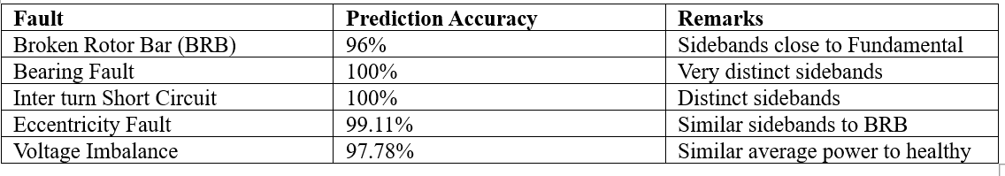
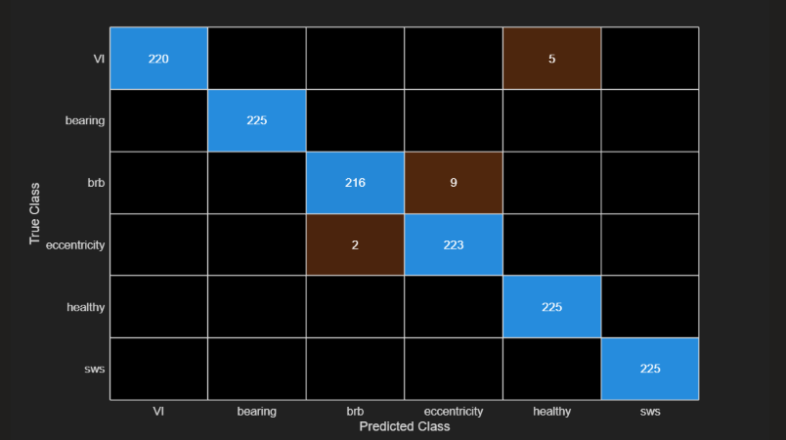

Slide 14
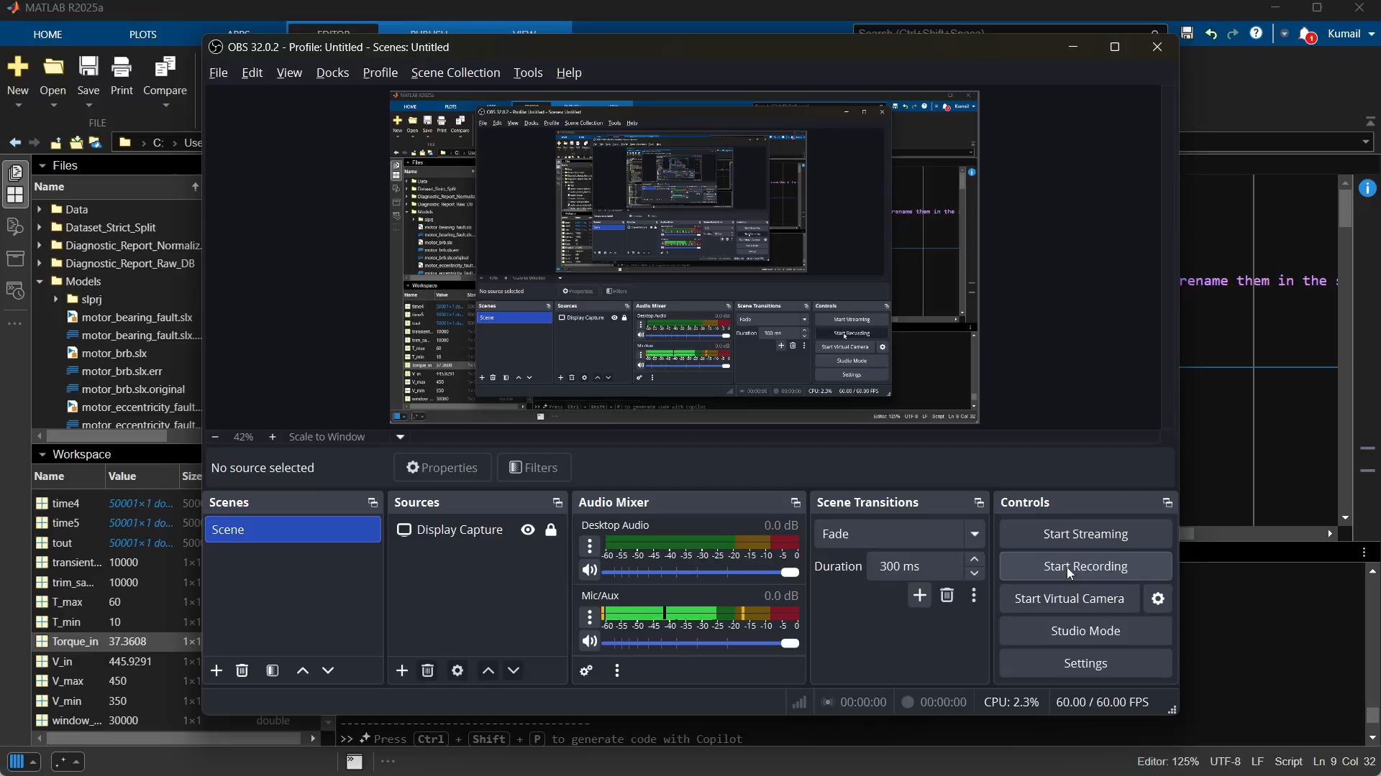

Slide 15
Conclusion
Key Takeaways: Deep learning can accurately diagnose complex motor faults. Use of RGB spectrograms was highly effective in differentiating between these faults
Limitations: This model relies on simulation, not actual hardware data due to budget constraints. While we modelled noise and drift, real industrial environments may contain interference or extra noise that we not captured in training
Future Work: Training the model on an embedded system like Raspberry Pi with sensors for real-time monitoring and validating results on a physical motor test rig

Slide 16
Current Research Areas
Multi-sensor fusion and advanced time–frequency analysis for detecting subtle motor faults.
Real-time embedded AI systems designed for on-device industrial motor monitoring.
Digital twins, RUL prediction, and explainable AI for predictive maintenance.
Physics-aware machine learning models that integrate motor theory with data-driven fault diagnosis.
References
Broken Rotor Bar (BRB) Fault Severity Reference : A. Bellini, F. Filippetti, G. Franceschini, C. Tassoni, and G. B. Kliman, “Quantitative evaluation of induction motor broken bars by means of electrical signature analysis,” IEEE Transactions on Industry Applications, vol. 37, no. 5, pp. 1248–1255, 2001.
Voltage Imbalance (VI) Reference : Advanced Manufacturing Office, Energy Efficiency and Renewable Energy, “Eliminate Voltage Unbalance in Motor Systems,” U.S. Department of Energy, Washington, DC, 20585-0121. (Available online: energy.gov — 2014.)
Eccentricity Fault Reference : D. G. Dorrell, W. T. Thomson, and S. Roach,
“Analysis of airgap flux, current, and vibration signals as a function of static and dynamic airgap eccentricity in 3-phase induction motors,” IEEE Transactions on Industry Applications, vol. 33, no. 1, pp. 24–34, 1997.
Bearing Fault Reference : R. R. Schoen, T. G. Habetler, F. Kamran, and R. G. Bartheld,
“Motor bearing damage detection using stator current monitoring,” IEEE Transactions on Industry Applications, vol. 31, no. 6, pp. 1274–1279, 1995.

